Slide 1
Employee Data Analysis using Excel
STUDENT NAME: SHIRIYA.A
REGISTER NO: 312209812 (&) asunm1353312209812
DEPARTMENT: BCOM[COMPUTER APPLICATION]
COLLEGE: ANNA ADARSH COLLEGE FOR WOMEN.

Slide 2
PROJECT TITLE
Employee Salary Analysis using Excel

Slide 3

AGENDA
Problem Statement
Project Overview
End Users
Our Solution and Proposition
Dataset Description
Modelling Approach
Results and Discussion
Conclusion
3/21/2024 Annual Review

Slide 4
PROBLEM STATEMENT
"Analyze the salary distribution across different departments and job roles within the company using Excel to identify any significant disparities and ensure competitive and equitable compensation practices."
Breakdown:
Objective: To identify disparities in salary distribution.
Scope: Focus on departments and job roles.
Tool: Excel for data analysis.
Outcome: Ensure fair and competitive compensation practices.

Slide 5
PROJECT OVERVIEW
The project is based on creation of salary in excel with headers under the name name, department, salary, employment type and gender. It extracts the data provided and gives a pictographic representation, for a better knowledge.
Source: This is applicable for any organization.
Format: Google spreadsheet (.gsheet).
Key Fields: Employee type, Name, Department, Gender, Salary.

Slide 6

WHO ARE THE END USERS?
HR Department
Executive Management
Finance Department
Data Analysts
Department Heads and Managers
Employees (Indirectly)
Consultants

Slide 7
OUR SOLUTION AND ITS VALUE PROPOSITION
Solution
Data Cleaning and Preparation
Descriptive and Trend Analysis
Performance and Demographic Analysis
Visualization
Reporting and Recommendations
Value Proposition
Enhanced Decision-Making
Improved Workforce Management
Strategic Planning Support
Increased Efficiency
Better Employee Insights

Slide 8
Dataset Description
The dataset is sourced from an internal HR management system and is provided in an Google Sheets (.gsheet) format. It includes key fields such as Employee ID, Name, Department, Job Title, Age, Gender, Hire Date, Salary, and Performance Rating, capturing essential details for comprehensive workforce analysis.
1.Source
Introduction: Identifies where the dataset originates from.
Description: This could be an HR management system, internal company database, or a third-party data provider

Slide 9
Dataset Description
2. Format
Introduction: Specifies the format in which the dataset is provided.
Description: Typically a google spreadsheet (.gsheet), but could also be CSV, database export, or other formats.
3. Key Fields
Introduction: The attributes or columns which are: Name, Gender, Department, Salary, Employment Type.
Description: Includes important data elements such as Name, Department Gender, Salary,Employment Type.

Slide 10
THE "WOW" IN OUR SOLUTION
The standout feature of my Google Sheets workbook is the integration of slicers for both department and worker type. These slicers enable dynamic analysis of salary distributions, highlighting how temporary workers' salaries compare to those from other departments. This interactive functionality provides a clear and insightful view of salary data across different categories.
‹#›

Slide 11
MODELLING
Introduction: Modeling involves applying analytical techniques to the dataset to extract meaningful insights and predict future trends.
Description:
Descriptive Analysis: Utilize summary statistics and pivot tables to understand basic characteristics and distributions within the data.
Trend Analysis: Apply time series analysis to identify patterns and trends in hiring, salary changes, and performance over time.
‹#›

Slide 12
MODELLING
Predictive Modeling: Implement regression analysis or machine learning algorithms to forecast future trends, such as predicting employee turnover or performance outcomes based on historical data.
Segmentation Analysis: Use clustering techniques to group employees by similar attributes (e.g., department, performance level) for targeted insights and strategies.
‹#›

Slide 13
MODELLING
Data collection:
1)downloaded in Kaggle.
2)used edunet dashboard to download.
Feature collection:
1)highlighted.
2)removed the blanks.
Data cleaning:
1)identified missing values.
2)filtered the missing values.
‹#›

Slide 14
MODELLING
Performance level:
1)used formula.
2)identified.
Visualization:
1)easily identified.
2)easily accessed.
Summary:
1)to deal with employee.
2)easily the data can be taken.
‹#›

Slide 15
RESULTS
Salary Attribute using Slicer
Categories of Employee Attribute using Slicer:
Fixed Type
Permanent Type
Temporary Type

Slide 16
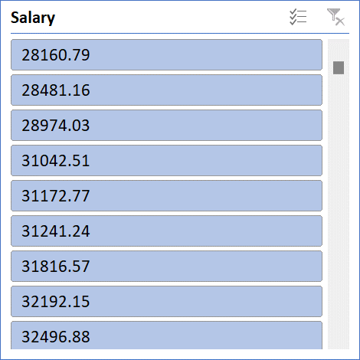
Salary Attribute
‹#›

Slide 17
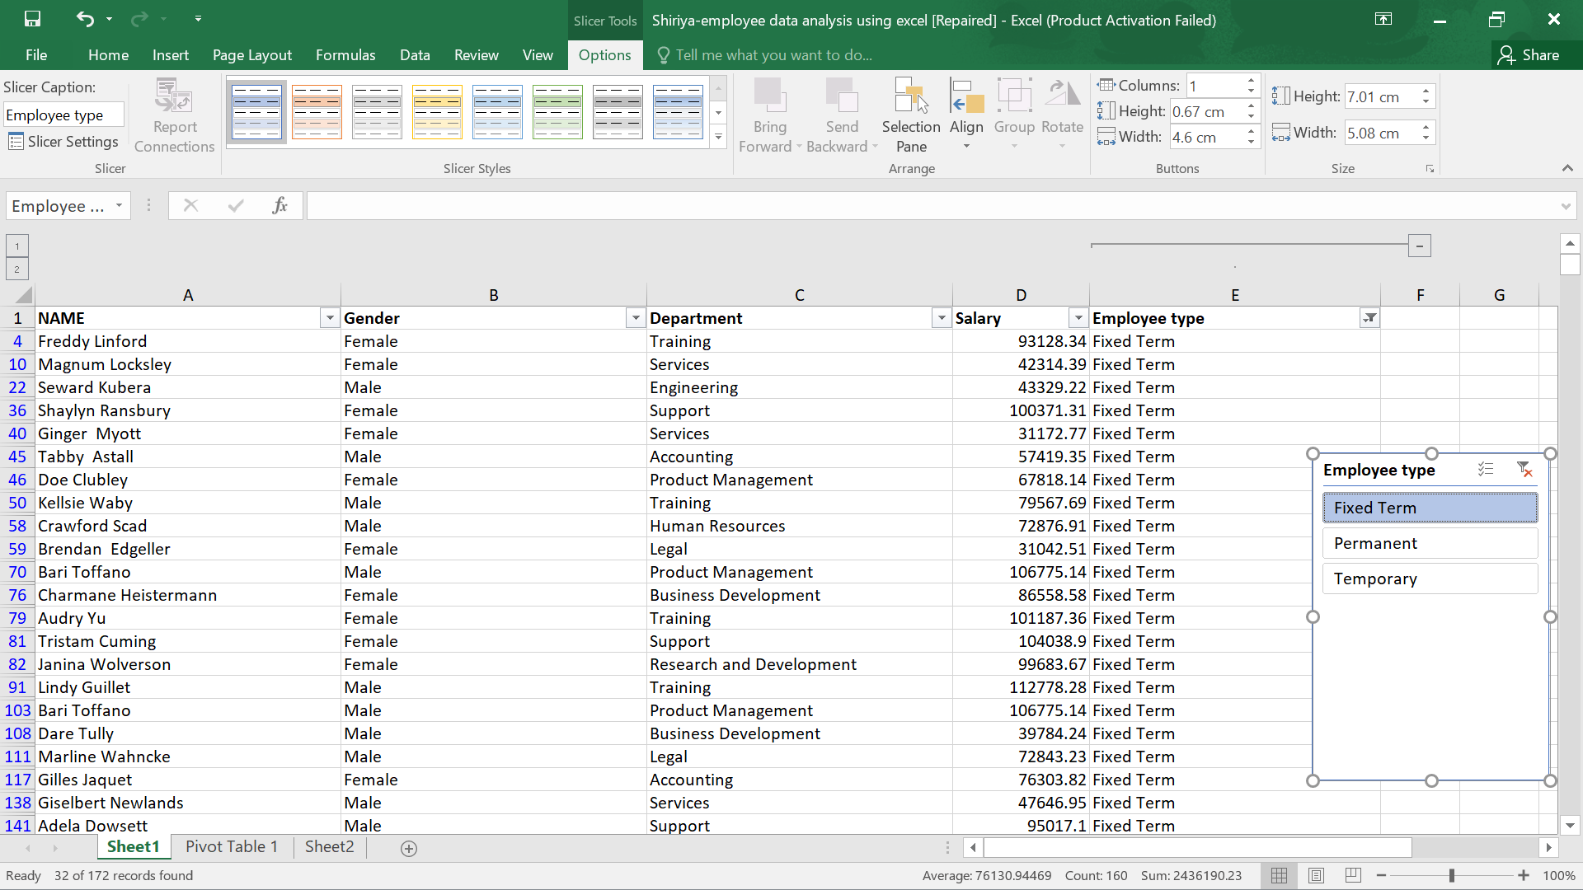
Fixed Type
‹#›

Slide 18
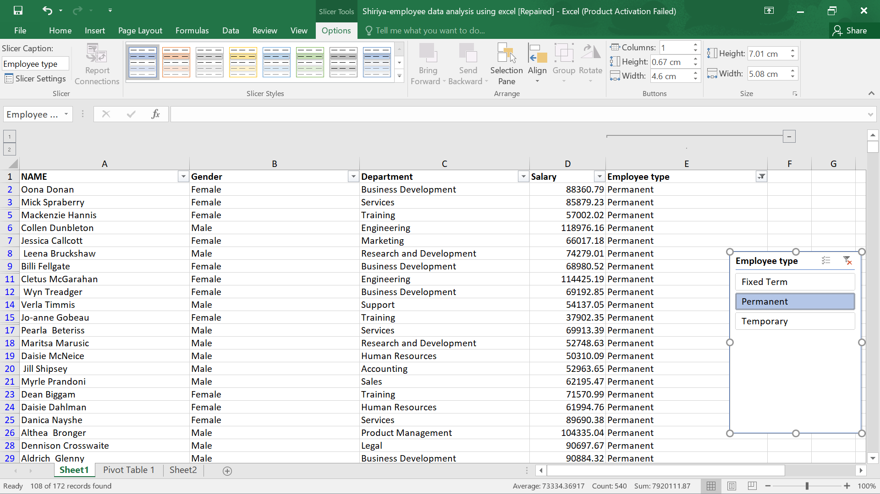
Permanent Type

Slide 19
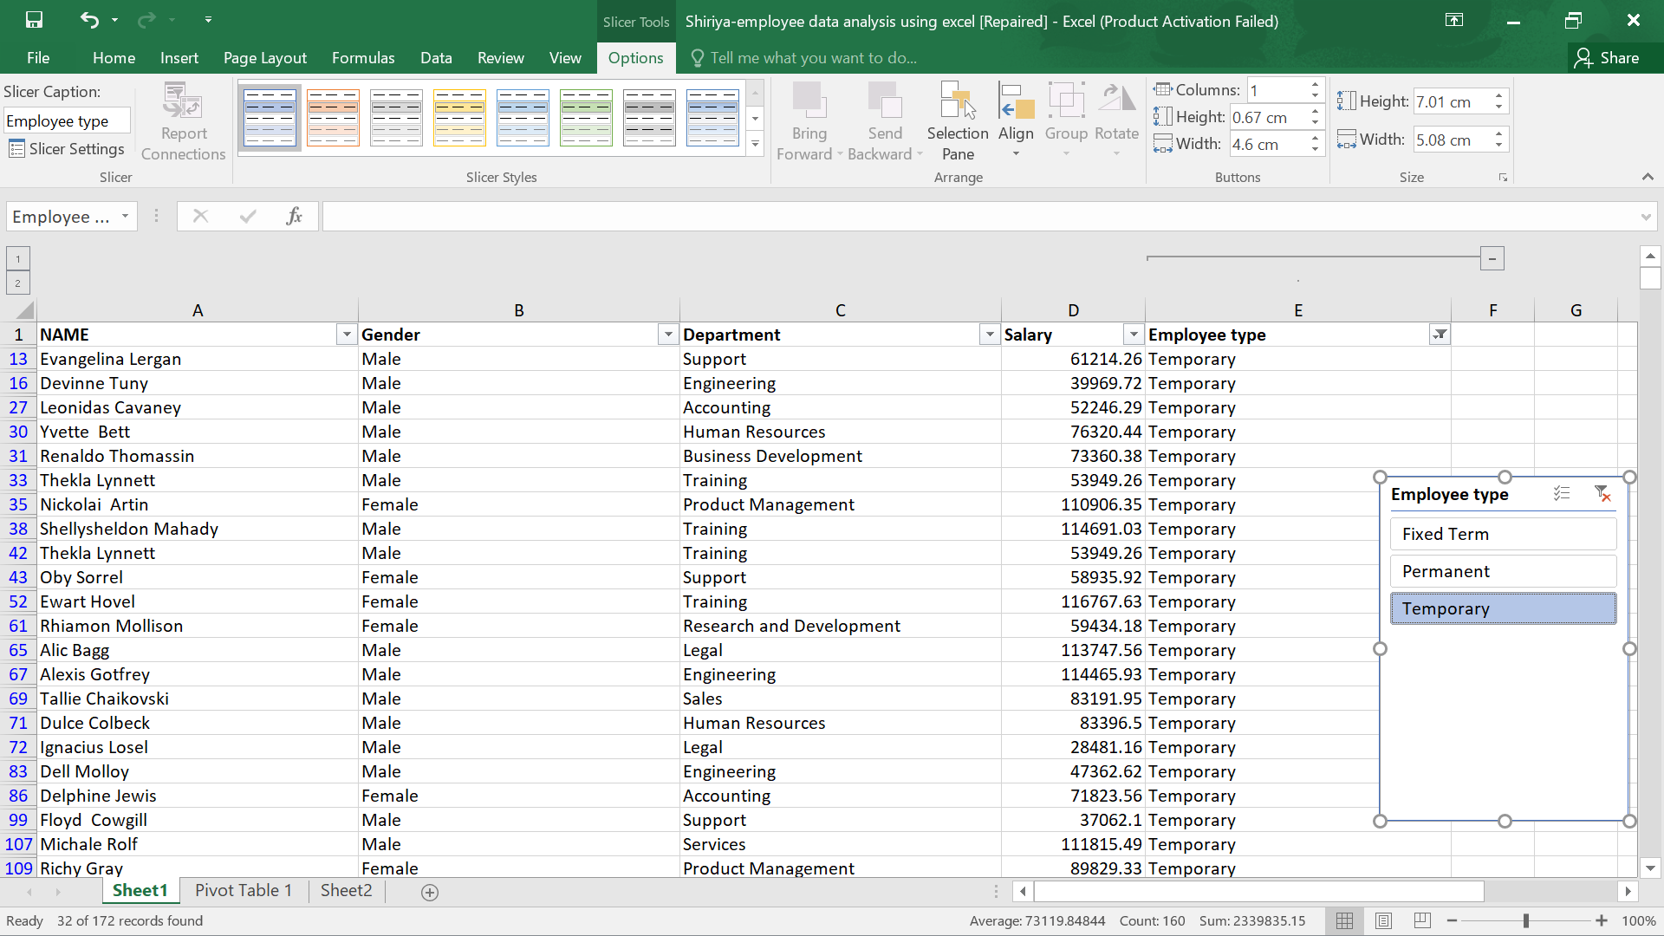
Temporary Type

Slide 20
Conclusion
Analyzing the employee dataset with Excel reveals key trends and patterns, improving HR decisions. Insights from the data help optimize workforce management, enhance strategic planning, and support informed decision-making, leading to more effective human resource practices.

